Slide 1

SSA CHATBOT
REDEFINING STUDENT SUPPORT THROUGH AI
Empowering students with real-time, emotion-aware AI support.

Slide 2

SSA CHATBOT
PAGE 02
PROBLEM STATEMENT
THE GAP IN STUDENT SUPPORT
Students often feel overwhelmed navigating tuition, OSAP, housing, and academic services. Existing systems are slow, fragmented, and emotionally disconnected.
Key Issues:
Delays in getting simple answers
Lack of personalized or empathetic support
Repetitive questions burdening advisors
Confusing navigation of college policies
“Information exists — but access is the problem.”

Slide 3

SSA CHATBOT
PAGE 03
We set out to build more than a bot. The goal was to create a smart, supportive, and responsive assistant that answers questions instantly and adapts to the student’s emotional tone.
PROJECT GOAL
AN ASSISTANT, NOT JUST A BOT
01
Provide fast, accurate answers via verified FAQs
02
Handle unseen questions using Gemini
03
Detect emotional tone and adapt replies
04
Escalate to human support when necessary

Slide 4
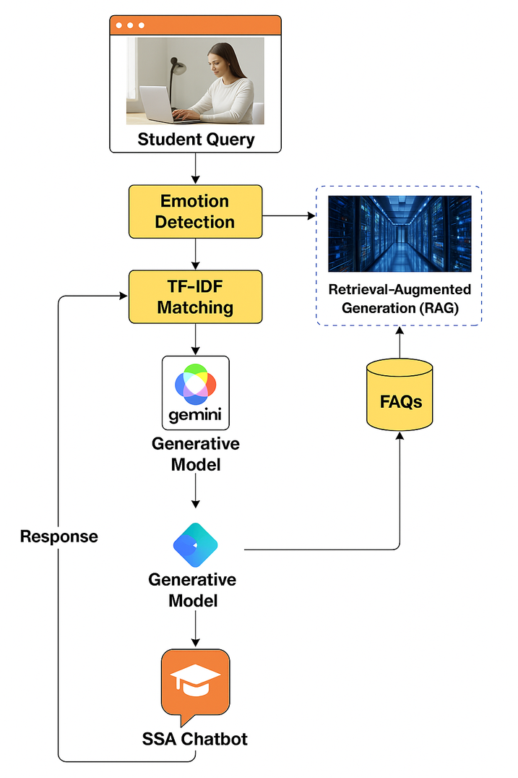
SSA CHATBOT
PAGE 04
ARCHITECTURE
The SSA Chatbot processes student queries through a structured, intelligent pipeline to deliver accurate, empathetic, and context-aware responses. It begins by detecting any emotional tone in the input, enabling personalized replies. The query is then matched using a TF-IDF search over curated FAQs. If a high-confidence match is not found, it proceeds to a Retrieval-Augmented Generation (RAG) system to search deeper policy documents. As a final fallback, the Gemini generative model creates a response based on the input context. This layered flow ensures both factual accuracy and supportive communication.

Slide 5
SSA CHATBOT
PAGE 05
EMOTION AWARENESS – RESPONDING LIKE A HUMAN
01
02
03
04
Detects sadness, anxiety, stress with pattern-based logic
Triggers empathetic replies automatically
Offers escalation if emotional distress is detected
Reinforces trust with caring tone
Tone matters. A student saying “I’m confused” needs a different response than “How much is tuition?”. Our emotion detector tailors the chatbot’s language to match the student’s mood.

Slide 6
SSA CHATBOT
PAGE 06
WHAT MAKES THIS CHATBOT STAND OUT
01
02
03
04
Three-layered fallback logic ensures no dead ends
Emotion-aware replies feel genuinely helpful
Gemini-powered follow-ups guide the next step
Minimal infrastructure — high impact
This is not just automation — it's intelligent student support. It adapts, understands, escalates, and guides. No other system on campus does all four.

Slide 7

SSA CHATBOT
PAGE 07
Developing trust in AI is as critical as accuracy. We faced challenges in balancing tone, generation quality, and fallback transitions — and refined them through experimentation.
CHALLENGES & LESSONS LEARNED
Gemini needs careful prompt tuning to avoid hallucination
01
02
Threshold tuning (e.g., 0.65 for FAQ match) is crucial
03
Regex emotion detection works but has limits — future: ML
04
The user experience must feel human, even if it's AI

Slide 8
SSA CHATBOT
PAGE 08
PLANNED UPGRADES:
01
Fine-tuned intent/emotion classifier (e.g., DistilBERT)
FUTURE PLANS – BEYOND A PROTOTYPE
02
Embedding-based FAQ retrieval (e.g., BGE + FAISS)
03
Admin dashboard to update FAQs dynamically
This chatbot is a strong foundation. Next, we aim to scale it into a full SSA assistant — integrating deeper understanding, analytics, and dynamic content.
04
Multi-turn conversation memory (chat history awareness)
05
Student usage analytics & feedback tracking

Slide 9

SSA CHATBOT
PAGE 09
CONCLUSION
A STEP TOWARD SMARTER SUPPORT
The SSA Chatbot reimagines how students interact with college services. It's not just faster — it's kinder, clearer, and always available. This is the future of student-facing AI: real-time, emotionally intelligent, and human-aligned.
“It’s not about replacing humans — it’s about helping students reach them better.”

Slide 10

SSA CHATBOT
PAGE 10
THANK YOU – TRY IT YOURSELF
GITHUB
Explore the full project, try the live demo, or contribute to future versions.
https://github.com/kittuai/Student-Services-Chatbot-Project
SSA BOOKING
studentsuccess.conestogac.on.ca/academic-guidance](https://studentsuccess.conestogac.on.ca/academic-guidance

